Slide 1
On the Feasibility of Large-Scale Infections of iOS Devices
Tielei Wang, Yeongjin Jang, Yizheng Chen, Simon Chung, Billy Lau, and Wenke Lee
Georgia Institute of Technology

Slide 2
Outline
Background and Motivation
Security Risks in Connecting iOS Devices to Compromised PCs
Measurement Results
Conclusion

Slide 3

Jekyll on iOS [USENIX Security’13]
We created a seemingly benign app named Jekyll and published it on the Apple App Store
Jekyll can be instructed to carry out malicious tasks by reordering and rearranging benign functionalities
Conclusion: Apple’s vetting process cannot prevent malicious apps

Slide 4

Key Limitation of Jekyll Apps
Jekyll apps did not get a lot of downloads
  Malicious apps, like any other apps, have the challenge of attracting attention from users
  Such apps can only affect a limited number of iOS users who accidentally download and run them

Slide 5
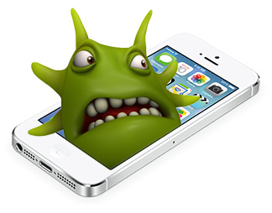
Motivation
Is it feasible to proactively deliver malicious apps to iOS devices at scale?

Slide 6
Attack Vector
We reviewed the iOS app distribution channels, and confirmed that PCs become a new attack vector to iOS devices
Install or remove apps
Access data in mobile devices

Slide 7
Contributions
Demonstrated security risks in connecting iOS devices to compromised computers
Measured the overlap between iOS devices and compromised Windows PCs

Slide 8
Outline
Background and Motivation
Security Risks in Connecting iOS Devices to Compromised PCs
Measurement Results
Conclusion

Slide 9
Attack I: Delivery of Jekyll Apps
Intuition: Attacker downloads a Jekyll app, and then injects the Jekyll app to plugged-in iOS devices
Challenge: Digital Rights Management (DRM) technology in iOS prevents users from sharing apps among arbitrary iOS devices

Slide 10
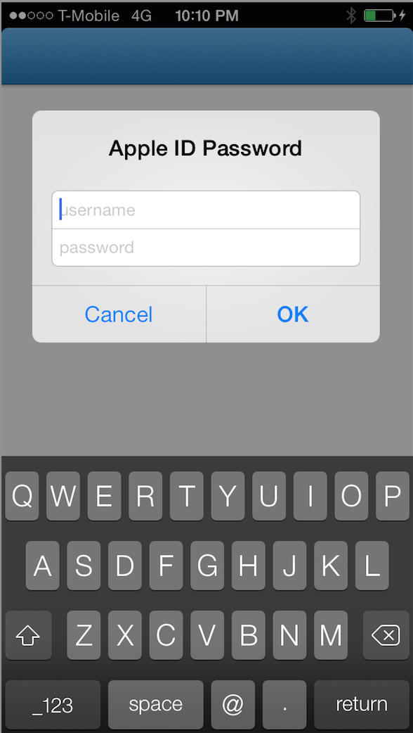
FairPlay DRM
Downloading apps from the App Store requires an Apple ID
User attempting to run an app downloaded by a different Apple ID on his iOS device needs to first enter the correct Apple ID and password
How to bypass the DRM protection?

Slide 11
Key Observation: iTunes Syncing
iTunes with Apple ID A
iOS device with Apple ID B
^{iTunes can authorize an iOS} ^{device} with a different Apple ID to run its apps
After syncing, apps purchased by Apple ID A can also run on the iOS device

Slide 12
The Detailed Process
iTunes with Apple ID A
iOS device with Apple ID B

Slide 13
The Man-in-the-Middle syncing
iTunes with Botmaster's
Apple ID A
iOS device with
Apple ID B

Slide 14
Attack I Summary
Attackers can remotely instruct an already compromised computer to install apps on a connected iOS device, completely bypassing DRM checks
Even if an app has been removed from the App Store, attackers can still distribute their own copies to iOS users
Although Apple has absolute control of the App Store, attackers can leverage MitM to build a covert distribution channel of iOS apps

Slide 15
Attack II: Delivery of Attacker-Signed Apps
Apple allows developers to test their apps on iOS devices through a process called device provisioning
A compromised computer can be instructed to provision a plugged-in iOS device without user knowledge
It allows the computer to further install any app signed by the attacker

Slide 16
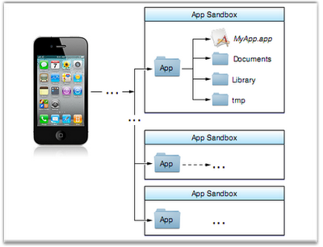
Attack III: Stealing Credentials
iOS Sandboxing
  Each app has a unique home directory for its file
  Apps are restricted from accessing files stored by other apps or from making changes to the device

Slide 17
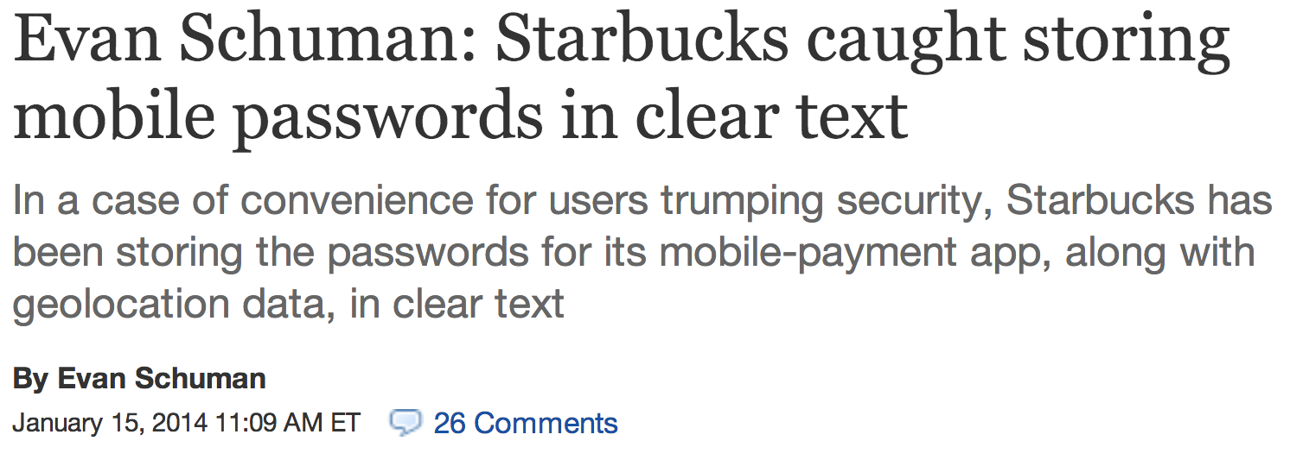
Attack III: Stealing Credentials
Many iOS apps store credentials in plaintext, because the developers presume that the iOS sandbox can prevent other apps from accessing files in their apps’ home directories

Slide 18

Attack III: Stealing Credentials
However, from a USB connection, a host computer has access to the contents of all apps

Slide 19
Attack III: Stealing Credentials
As a proof of concept, we implemented a tool that can retrieve the cookies of Facebook and Gmail apps from a USB-connected iOS device
By reusing the cookies, we successfully logged in as the iOS user via the web services for both Facebook and Gmail

Slide 20
Outline
Background and Motivation
Security Risks of Connecting iOS Devices to Compromised PCs
Measurement Results
Conclusion

Slide 21
The Goal of the Measurement
To quantitatively estimate how many users would connect iOS devices to compromised PCs
Compromise PCs
iOS Devices

Slide 22
Two Main Datasets
DNS Query Dataset
  Obtained from two large ISPs in the US, collected in 13 cities for five days in Oct 2013
  54 million client IDs, 62 million queries, and 12 billion records daily from 13 sensors in total
Labeled C&C Domains
  Obtained command and control (C&C) domain names for botnets that Damballa is tracking

Slide 23



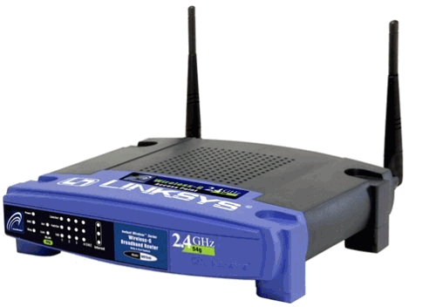
Basic Information
We know DNS queries from this IP address
192.168.0.1
192.168.0.2
Home
Network
Internet
NAT
192.168.0.3
143.215.130.78

Slide 24

Step1: Determine Bot Population
If a CID queried any C&C domain in a day, we consider it as having a bot at home for that day
192.168.0.1
192.168.0.2
Home
Network
Internet
192.168.0.3
473,506 infected CIDs on 10/12/2013.

Slide 25
Step2: Exclude Mac OS X
Mac OS X is set to automatically check for security updates daily since version 10.6
swscan.apple.com
swquery.apple.com
swdist.apple.com
swdownload.apple.com
swcdn.apple.com
192.168.0.1
Home
Network
Internet
192.168.0.3
After excluding Mac OS X, we have 466,540 bot CIDs

Slide 26
Step3: Determine coexistence of iOS
We used unique domains from two default apps and one service in iOS (the Weather app, Stocks app, and Location Services) to get a lower bound of CIDs containing iOS devices
192.168.0.1
Home
Network
Internet
192.168.0.3
Of 466,540 CIDs without Mac OS X traffic, 142,907 queried these domains

Slide 27

Step4: Determine Windows iTunes Purchases
Connecting iOS devices to a PC does not generate observable network traffic

Slide 28
Step4: Determine Windows iTunes Purchases
More evidences
  If iTunes is installed on a user’s PC and is also used to purchase some items from the App Store, the user will eventually connect her iOS devices to the PC

Slide 29
Step4: Determine Windows iTunes Purchases
Solution: Leverage iOS heartbeat DNS queries
  iOS devices must send an HTTP request to init-p01st.push.apple.com to get push server configurations at least every 1,800s
Heartbeat
Query
App Store
Purchase
time
2-hour time-windows
Issued from Windows PC
Issued from iOS

Slide 30
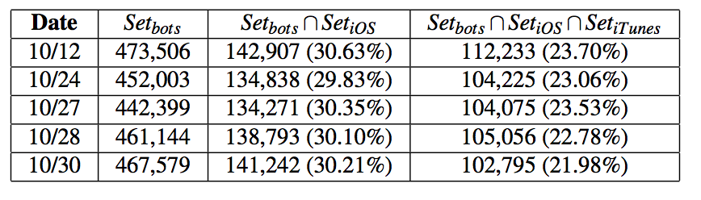
Measurement Summary
23% of all bot population have connections with iOS devices

Slide 31
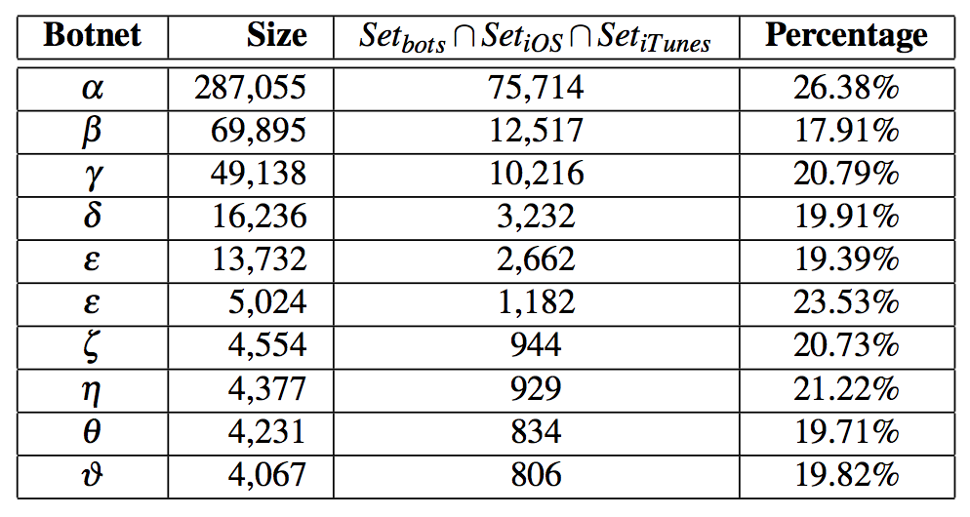
Measurement Summary
23% of all bot population have connections with iOS devices

Slide 32
Outline
Background and Motivation
Security Risks of Connecting iOS Devices to Compromised PCs
Measurement Results
Conclusion

Slide 33
Conclusion
Demonstrated attacks:
  Bypass Apple DRM and install Apple-signed malicious apps
  Stealthily provision the devices and install attacker-signed malicious apps
  Obtain app credentials (e.g., Gmail and Facebook cookies)
Measurement Results: 23% of all bot population have connections with iOS devices

Slide 34
Questions?

