Slide 1
Top Ten Web Hacking Techniques of 2013

Slide 2
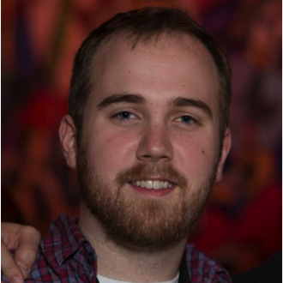

Matt Johansen
Head of WhiteHat's Threat Research Center
BlackHat, DEFCON, RSA, etc. Speaker
Oversees assessment of 20,000+ websites
Background in Penetration Testing
Hacker turned Management
I'm hiring… a lot
Threat Research Center, Manager
Twitter: @mattjay
Email: matt@whitehatsec.com

Slide 3
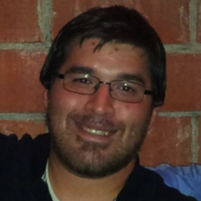
Johnathan Kuskos
Supervisor/Engineer for WhiteHat’s Threat Research Center
Primarily interested in WAF evasion research and business logic abuse
Bug Bounty Hunter & CTF Enthusiast
Houston OWASP Chapter Leader
Houston InfoSec Founder
Threat Research Center, Senior Application Security Engineer
Twitter: @JohnathanKuskos
Email: johnathan.kuskos @whitehatsec.com

Slide 4








About WhiteHat Security
Headquartered in Santa Clara, California
WhiteHat Sentinel: SaaS end-to-end website risk management platform (static and dynamic vulnerability assessment)
Employees: 340+

Slide 5
About the Top Ten

Slide 6
“Every year the security community produces a stunning amount of new Web hacking techniques that are published in various white papers, blog posts, magazine articles, mailing list emails, conference presentations, etc. Within the thousands of pages are the latest ways to attack websites, Web browsers, Web proxies, and their mobile platform equivalents. Beyond individual vulnerabilities with CVE numbers or system compromises, here we are solely focused on new and creative methods of Web-based attack.”

Slide 7
History: Past Years
2011 (51 new techniques)
BEAST
2010 (69 new techniques)
'Padding Oracle' Crypto Attack
2009 (80 new techniques)
Creating a rogue CA certificate
2008 (70 new techniques)
GIFAR (GIF + JAR)
2007 (83 new techniques)
XSS Vulnerabilities in Common Shockwave Flash Files
2006 (65 new techniques)
Web Browser Intranet Hacking / Port Scanning
2012 (56 new techniques)
CRIME

Slide 8
The Year 2013
31 NEW Techniques
Mutation XSS
BREACH
Pixel Perfect Timing Attacks with HTML5
Lucky 13
Weaknesses in RC4
XML Out of Band Data Retrieval
Million Browser Botnet
Large Scale Detection of DOM based XSS
Tor Hidden Service Passive Decloaking
HTML5 Hard Disk Filler
https://blog.whitehatsec.com/top-10-web-hacking-techniques-2013/

Slide 9

2013 Top Ten
10
HTML5 Hard Disk Filler
“The HTML5 Web Storage Standard was developed to allow sites to store larger amounts of data(5-10 Megabytes) than was previously allowed by cookies(4 Kilobytes). localStorage is awesome because it’s supported in all modern browsers(Chrome, Firefox 3.5+, Safari 4+, IE 8+, etc). It’s not a bug with HTML5, nor the Web Storage Standard, but rather with how browsers have implemented the standard.”
Feross Aboukhadijeh
https://www.youtube.com/watch?v=XkScSMIr_00
http://feross.org/fill-disk/
http://www.filldisk.com/ ← Disclaimer: Exploit runs upon visiting this URL. Use at your own risk.

Slide 10
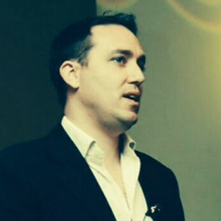
2013 Top Ten
9
Tor Hidden-Service Passive Decloaking
“Someone recently asked me if I knew how to find where Tor-hidden services were really hosted. I identified a few possible methods for finding the origin servers, but none of them worked universally – or even in most situations. Eventually, I did find one way to definitively locate an origin server. However, that method is not trivial – and is still just theoretical.”
Robert “RSnake” Hansen
https://blog.whitehatsec.com/tor-hidden-service-passive-de-cloaking/

Slide 11
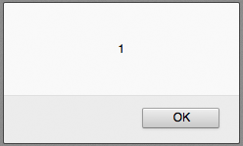
8
Large-scale Detection of DOM-based XSS
“In recent years, the Web witnessed a move towards sophisticated client-side functionality. This shift caused a significant increase in complexity of deployed JavaScript code and thus, a proportional growth in potential client- side vulnerabilities, with DOM-based Cross-site Scripting being a high impact representative of such security issues. In this paper, we present a fully automated system to detect and validate DOM-based XSS vulnerabilities, consisting of a taint-aware JavaScript engine and corresponding DOM implementation as well as a context-sensitive exploit generation approach.”
Sebasitan Lekies, Ben Stock, and Martin Johns
http://ben-stock.de/wp-content/uploads/domxss.pdf

Slide 12

7
Million Browser Botnet
“Online advertising networks can be a web hacker’s best friend. For mere pennies per thousand impressions (that means browsers) there are service providers who allow you to broadly distribute arbitrary javascript -- even malicious javascript! You are SUPPOSED to use this “feature” to show ads, to track users, and get clicks, but that doesn’t mean you have to abide. Absolutely nothing prevents spending $10, $100, or more to create a massive javascript-driven browser botnet instantly. The real-world power is spooky cool. We know, because we tested it… in-the-wild.”
Jeremiah Grossman & Matt Johansen
https://www.youtube.com/watch?v=ERJmkLxGRC0
http://blackhat.com/us-13/briefings.html#Grossman
http://www.slideshare.net/jeremiahgrossman/million-browser-botnet

Slide 13

6
XML Out of Band Data Retrieval
Timur Yunusov(Web Application Security Researcher) and Alexey Osipov(Attack Prevention Mechanisms Researcher) presented to the world a novel technique for accessing “out-of-band” data. “It allows us to access files and resources from victim’s machine and internal network, even when normal output is possible from the vulnerable application that handles XML data.”
Timur Yunusov and Alexey Osipov
https://media.blackhat.com/eu-13/briefings/Osipov/bh-eu-13-XML-data-osipov-slides.pdf
http://www.youtube.com/watch?v=eBm0YhBrT_c

Slide 14

5
Weaknesses in RC4
“We have found new attacks against TLS that allows an attacker to recover a limited amount of plaintext from a TLS connection when RC4 encryption is used. The attacks arise from statistical flaws in the keystream generated by the RC4 algorithm which become apparent in TLS ciphertexts when the same plaintext is repeatedly encrypted.”
Nadhem AlFardan, Dan Bernstein, Kenny Paterson, Bertram Poettering and Jacob Schuldt
http://www.isg.rhul.ac.uk/tls/

Slide 15
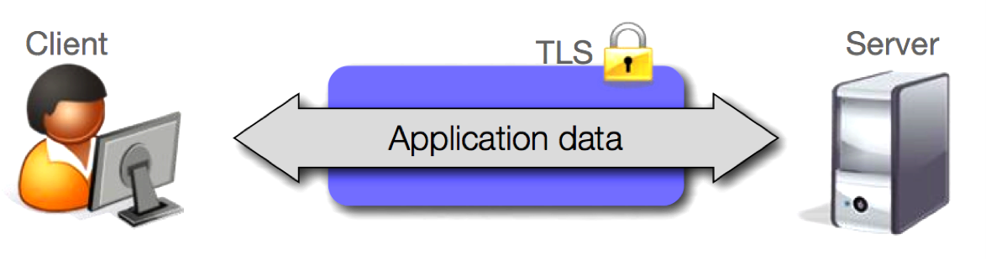
RC4
SSL and TLS
Used to encrypt web traffic between client and server
Implemented in popular Secure Protocols
HTTPS, IMAP/TLS, POP/TLS, SMPT/TLS, WPA/TKIP etc.
Can support multiple encryption algorithms including RC4, CBC, etc.
Each algorithm has a number of ciphersuites
Source: http://www.isg.rhul.ac.uk/tls/usenix-presentation.pdf

Slide 16
RC4
What is RC4?
RC4 is a fast stream cipher invented in 1987 by Ron Rivest.
It does not require padding or IVs, which means it's immune to recent TLS attacks like BEAST and Lucky13.
RC4 takes a short (e.g., 128-bit) key and stretches it into a long string of pseudo-random bytes. These bytes are XORed with the message you want to encrypt, resulting in what should be a pretty opaque (and random-looking) ciphertext.
Research has proven this somewhat incorrect as the “randomness” has shown some small biases based on large data set statistical analysis.
Take many encryptions of the same message and analyze the small deviations to read the encrypted message.
Source: http://blog.cryptographyengineering.com/2013/03/attack-of-week-rc4-is-kind-of-broken-in.html

Slide 17
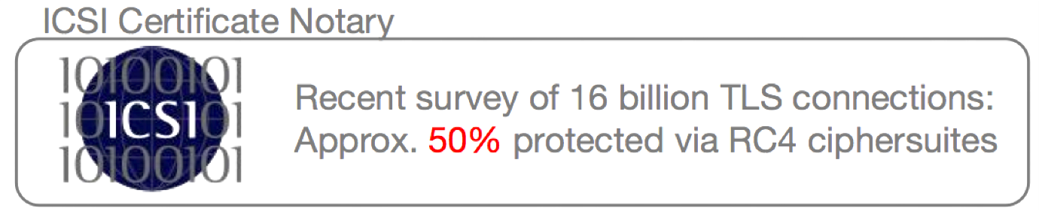
RC4
Distribution of RC4
Recent attacks on CBC based ciphersuites in TLS
Last 3 years Top 10 & This Years #3 (BEAST, Lucky 13, etc.)
Suggestions have been to move TO RC4

Slide 18
RC4
First Attack
Multi Session Attack
Requires target plaintext to be repeatedly sent in multiple TLS connections.
Exploits single-byte biases in the initial 256 bytes of RC4 keystreams.
Need 2³⁰ TLS connections to reliably recover 220 of the first 256 bytes of plaintext.
Improved to 2²⁴ to recover certain bytes reliably.

Slide 19
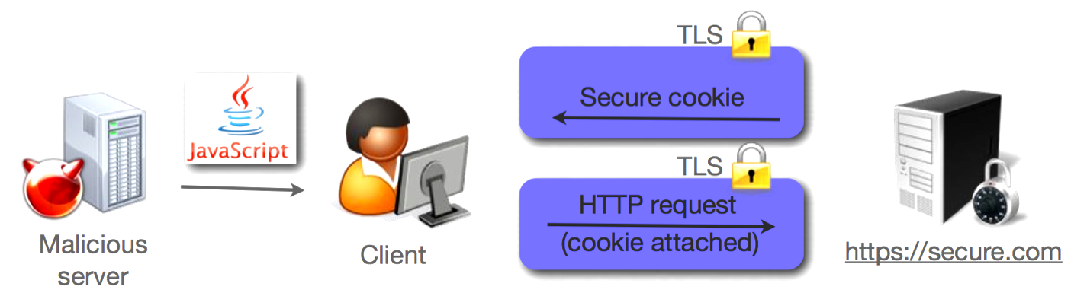
RC4
Real World Scenario
Many encryptions of same plaintext are required.
What is a real world example of encrypting the same plaintext over and over again?
Secure Session Cookies!

Slide 20
RC4
Real World Scenario
Math goes from our enemy to our friend.
Reduce possibilities of outcome by optimizing analysis with prior knowledge.
Cookie example with Gmail (which uses RC4 enabled TLS)
We know things about the plaintext! Base64 encoded cookies would reduce possible character set, etc.
With a bit of JavaScript in a victim’s browser, we can force many HTTPS connections to Gmail and rack up enough for a MiTM to analyze.
Still slightly impractical due to number needed but that could get better in the future.

Slide 21
RC4
Second Attack
Single connection/session attack
Exploits double-byte biases in RC4 keystreams (the Fluhrer-McGrew biases).
10 x 2³⁰ encryptions needed to recover a set of 16 consecutive bytes of plaintext.
6 x 2³⁰ will achieve a 50% reliability.
TLS handshake does not need to be rerun which makes this more efficient than the single-byte bias attack

Slide 22
RC4
Limitations
Feasible but not practical
2²⁸ ~ 2³² sessions for reliable recovery of initial bytes
2³³ ~ 2³⁴ encryptions for reliable recovery of 16 bytes anywhere in plaintext

Slide 23
RC4
Countermeasures
Stop using RC4 and start using new (preferably authenticated) encryption modes.
If stuck on RC4, discard more initial keystream bytes. Increases the limitations of the attack.
Limit number of times cookies can be sent in a certain timeframe to stop that attack scenario.

Slide 24
4
Lucky13
“The Transport Layer Security (TLS) protocol aims to provide confidentiality and integrity of data in transit across untrusted networks like the Internet. It is widely used to secure web traffic and e-commerce transactions on the Internet. Datagram TLS (DTLS) is a variant of TLS that is growing in importance. We have found new attacks against TLS and DTLS that allow a Man-in-the-Middle attacker to recover plaintext from a TLS/DTLS connection when CBC-mode encryption is used. The attacks arise from a flaw in the TLS specification rather than as a bug in specific implementations.”
Nadhem AlFardan and Kenny Paterson
http://www.isg.rhul.ac.uk/tls/Lucky13.html

Slide 25
Lucky 13
The team behind the research
Kenny Paterson
Professor of Information Security and an EPSRC Leadership Fellow in the Information Security Group
Nadhem AlFardan
PhD student in the Information Security Group at Royal Holloway, University of London

Slide 26
Lucky 13
Versions in question
The Lucky Thirteen attack applied(now fixed) to all TLS and DTLS implementations that are compliant with versions:
TLS 1.1
TLS 2.2
DTLS 1.0
DTLS 1.2
SSL 3.0
TLS 1.0
Affected Ciphersuites: All TLS/DTLS ciphersuites that include CBC-mode
Affected Implementations: OpenSSL and GnuTLS

Slide 27
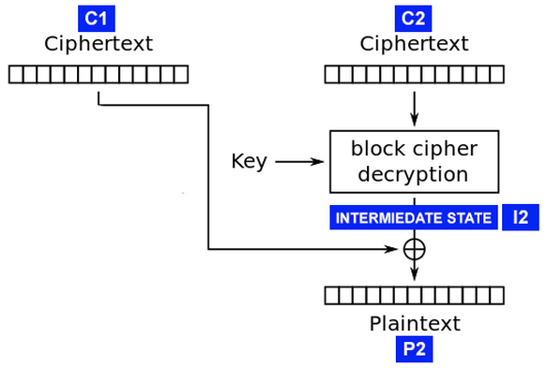
Lucky 13
So how does it work?
It uses what’s known as a padding oracle attack.
Data is processed into 16 byte chunks using MEE, which runs data through a Message Authentication Code(MAC) algorithm, then encodes and encrypts it.
MEE adds padding to the ciphertext so that it’s either in 8 or 16 byte boundaries.
When TLS decrypts the ciphertext, the padding is removed.

Slide 28
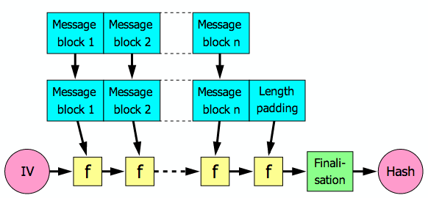
Lucky 13
Hash-Based Message Authentication Code

Slide 29
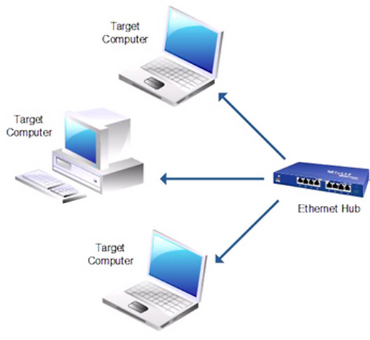
Lucky 13
Real World Complexities
The attack is multisession
“The target plaintext must be repeatedly sent in the same position in the plaintext stream in multiple TLS sessions”
The attacker must be on the same LAN as the victim

Slide 30
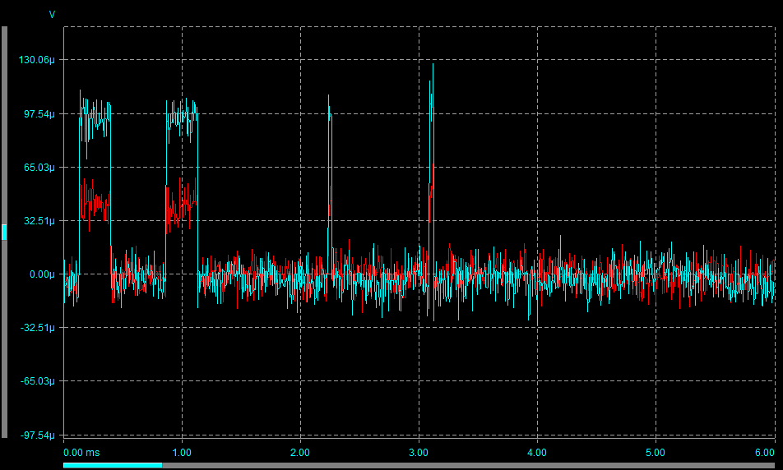
Lucky 13
Network Jitter!
Must be measured
Probably not feasible over the internet
Wifi noise is doubtful as well
IF it is noisy, it must be “consistently” noisy
The prize: 16 bytes of encrypted plaintext

Slide 31
Lucky 13
DTLS=Practical’ish; TLS=Theoretical
When a record fails to decrypt the TLS server kills the session
Padding error
Bad MAC
However, DTLS keeps the session open!
Still takes millions of sessions to attack though

Slide 32

Lucky 13
Should we be worried?
Responsible Disclosure was used and several vendors were informed prior to the researches release, including:
OpenSSL, NSS, gnuTLS, PolarSSL, CyaSSL, MatrixSSL, Opera, F5, BouncyCastle, Oracle, Apple, Cisco, Microsoft, et al.
“It is a truism that attacks only get better with time, and we cannot anticipate what improvements to our attacks, or entirely new attacks, may yet to be discovered.”

Slide 33
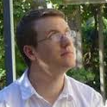
3
Pixel Perfect Timing Attacks with HTML5
“The new HTML5 requestAnimationFrame API can be used to time browser rendering operations and infer sensitive data based on timing data. Two techniques are demonstrated which use this API to exploit timing attacks against Chrome, Internet Explorer and Firefox in order to infer browsing history and read cross-origin data from other websites. The first technique allows the browser history to be sniffed by detecting redraw events. The second shows how SVG filters can be used to read pixel values from a web page. This allows pixels from cross-origin iframes to be read using an OCR-style technique to obtain sensitive data from websites.”
Paul Stone
http://contextis.co.uk/research/white-papers/pixel-perfect-timing-attacks-html5/

Slide 34
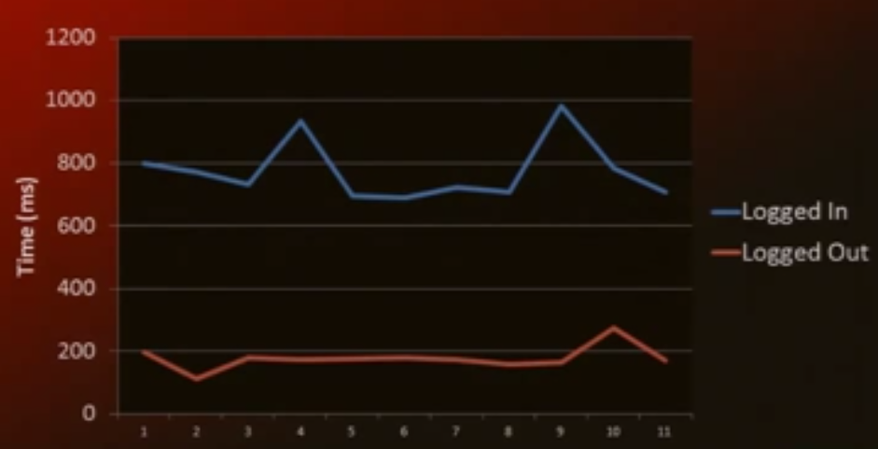
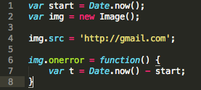
Pixel Perfect Timing
Browser History Sniffing
HTML5 Techniques
Read Browser History Sniffing – Link Colors
Read contents of framed contents with timing attacks
Timing login detection with JavaScript
Not reliable over the internet
Source: BlackHat – Paul Stone - https://www.youtube.com/watch?v=KcOQfYlyIqw

Slide 35
Pixel Perfect Timing
History of browser history sniffing
Check the CSS! Create a link, check if its blue or purple.
Ad networks and porn sites loved this and used it on their own users
This is fixed since 2010

Slide 36
Pixel Perfect Timing
What’s old is new again!
Enter requestAnimationFrame()
This is a function that is called just before each frame is painted in the browser. (Think refresh rate on your display)
Can be used in conjuncture with purposely slowing down certain rendering in a timing attack

Slide 37
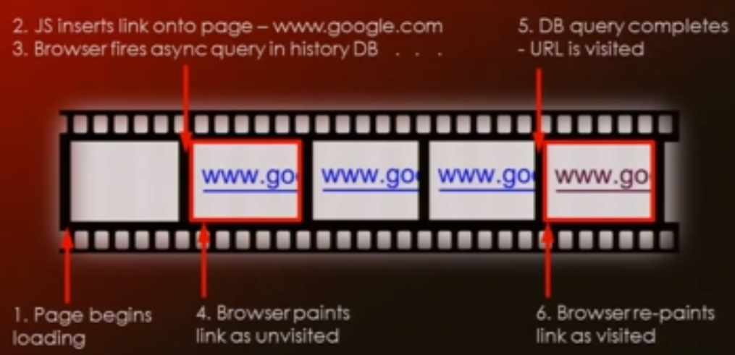
Pixel Perfect Timing
Frame by Frame
Source: BlackHat – Paul Stone - https://www.youtube.com/watch?v=KcOQfYlyIqw

Slide 38
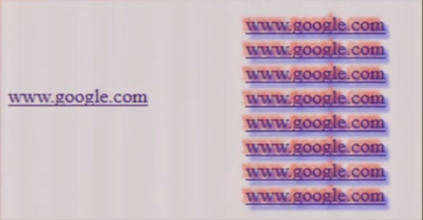
Pixel Perfect Timing
Simma Down Now
With normal repainting rates, everything is normal at 16ms per frame. We want to slow down repainting to notice when its happening.
Text-shadow: 5px 5px 10px red
Source: BlackHat – Paul Stone - https://www.youtube.com/watch?v=KcOQfYlyIqw

Slide 39
Pixel Perfect Timing
How it works
Load a frame with a ton of links to 1 URL with the slowing text shadow
Use requestAnimationFrame to time the next few frames
If 1 slow frame (1 repaint) – Link must be blue and unvisited
If 2 slow frames (2 repaints) – Link must be purple and visited

Slide 40
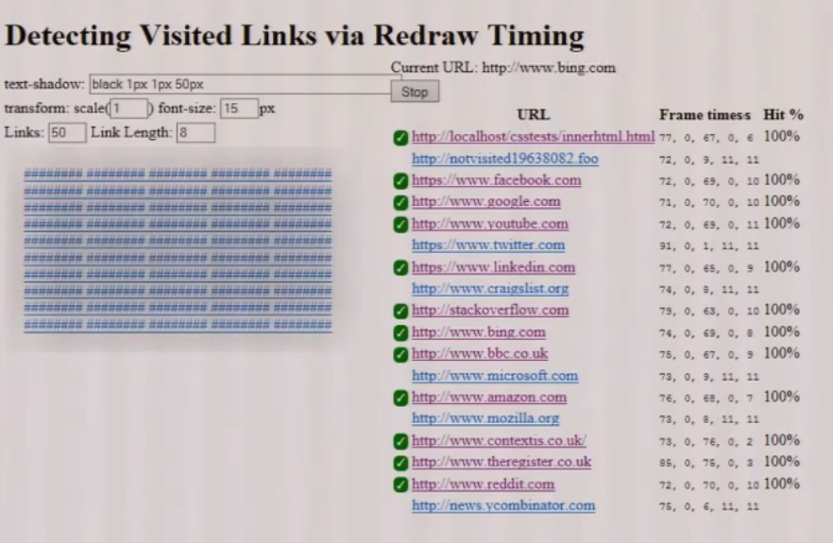
Pixel Perfect Timing
Source: BlackHat – Paul Stone - https://www.youtube.com/watch?v=KcOQfYlyIqw

Slide 41
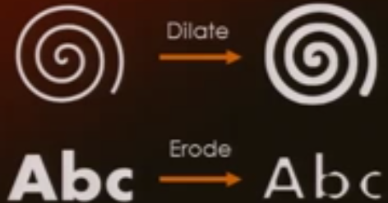
Pixel Perfect Timing
Part 2 – Reading Pixels
Enter SVG! – Scalable Vector Graphics (<circle>, <rect>, <path>, etc.)
Has a bunch of Filter Effects (blur, displacement maps, etc.)
Use these filters to alter appearance of any HTML element
<feMorphology> can either dialate or erode an image to make it appear thicker or thinner
Source: BlackHat – Paul Stone - https://www.youtube.com/watch?v=KcOQfYlyIqw

Slide 42


Pixel Perfect Timing
<feMorphology> Problem
Can potentially be slow if it has to read entire image
Optimization code exists for to speed this up but only usable in certain situations
Must use slow code
Can use optimized code

Slide 43
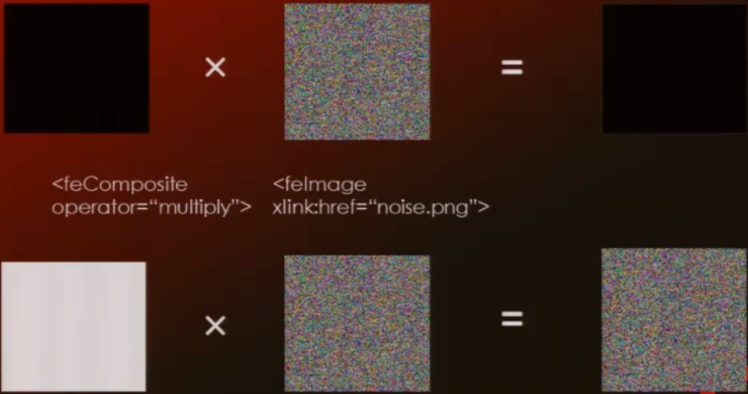
Pixel Perfect Timing
Real World Usage
Source: BlackHat – Paul Stone - https://www.youtube.com/watch?v=KcOQfYlyIqw

Slide 44
Pixel Perfect Timing
Real World Usage
Create a frame of the website you’d like to read out of
Take a snapshot in time of said frame
Apply an SVG ‘threshold’ filter to make every pixel either black or white
Multiply the image by the “noise” image and the result will be different based on black or white
Profit

Slide 45
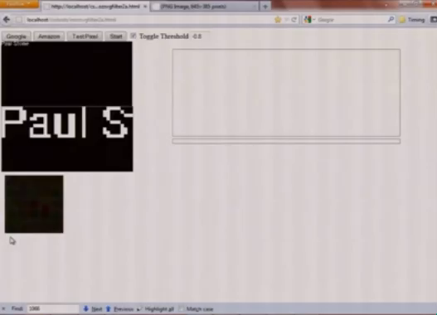
Pixel Perfect Timing

Slide 46
Pixel Perfect Timing
Other example
That is a bit slow and is copying an image
How about text? And faster?
Source code! <iframe src=“view-source:http://…”>
CSRF Tokens, Private information, etc.
We know the font (how the pixels are aranged)

Slide 47
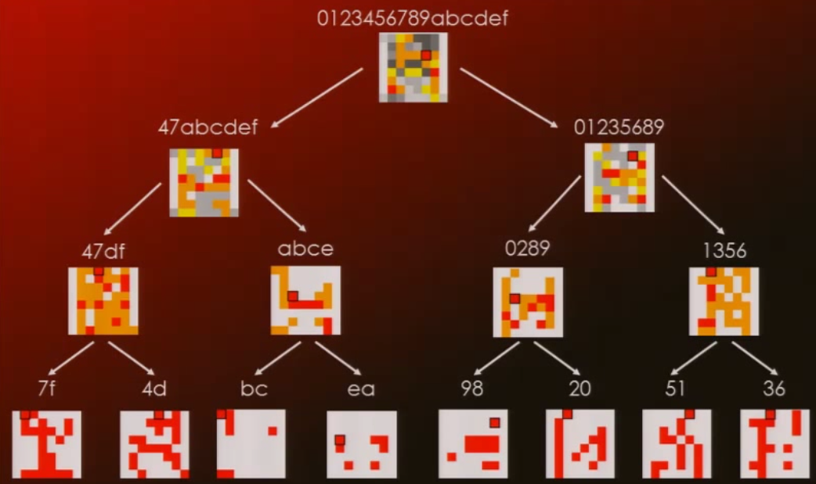
Pixel Perfect Timing

Slide 48
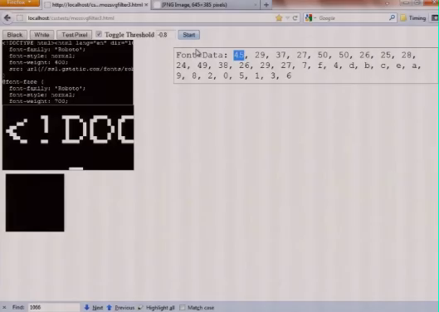
Pixel Perfect Timing

Slide 49
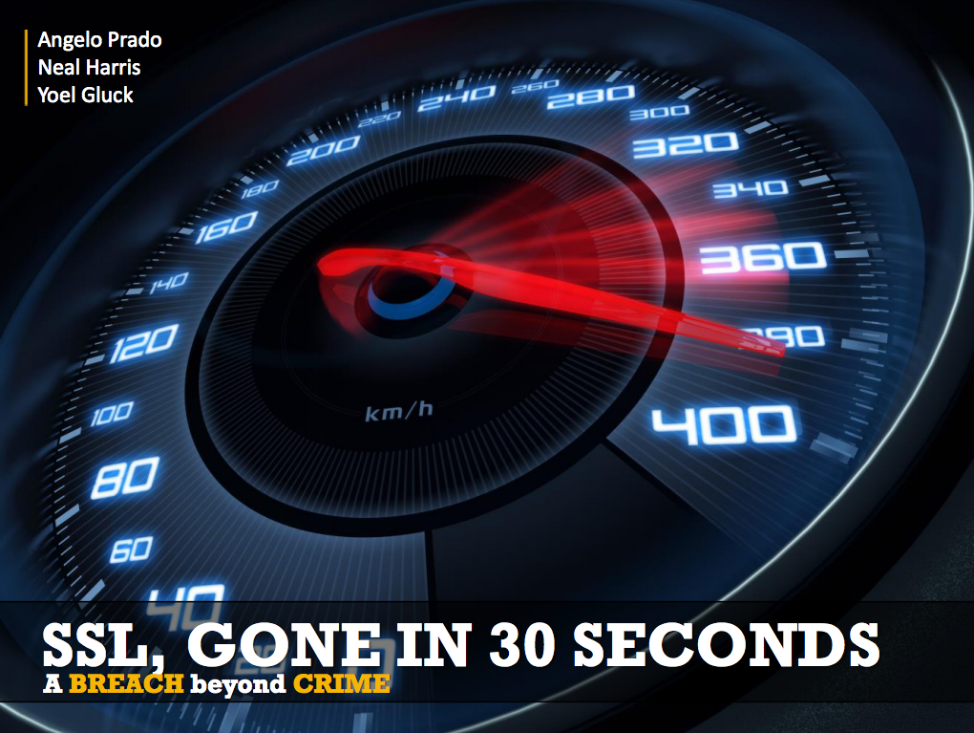
2
Breach
“In this hands-on talk, we will introduce new targeted techniques and research that allows an attacker to reliably retrieve encrypted secrets (session identifiers, CSRF tokens, OAuth tokens, email addresses, ViewState hidden fields, etc.) from an HTTPS channel. We will demonstrate this new browser vector is real and practical by executing a PoC against a major enterprise product in under 30 seconds. We will describe the algorithm behind the attack, how the usage of basic statistical analysis can be applied to extract data from dynamic pages, as well as practical mitigations you can implement today.”
Angelo Prado, Neal Harris, Yoel Gluck
https://media.blackhat.com/us-13/US-13-Prado-SSL-Gone-in-30-seconds-A-BREACH-beyond-CRIME-Slides.pdf

Slide 50
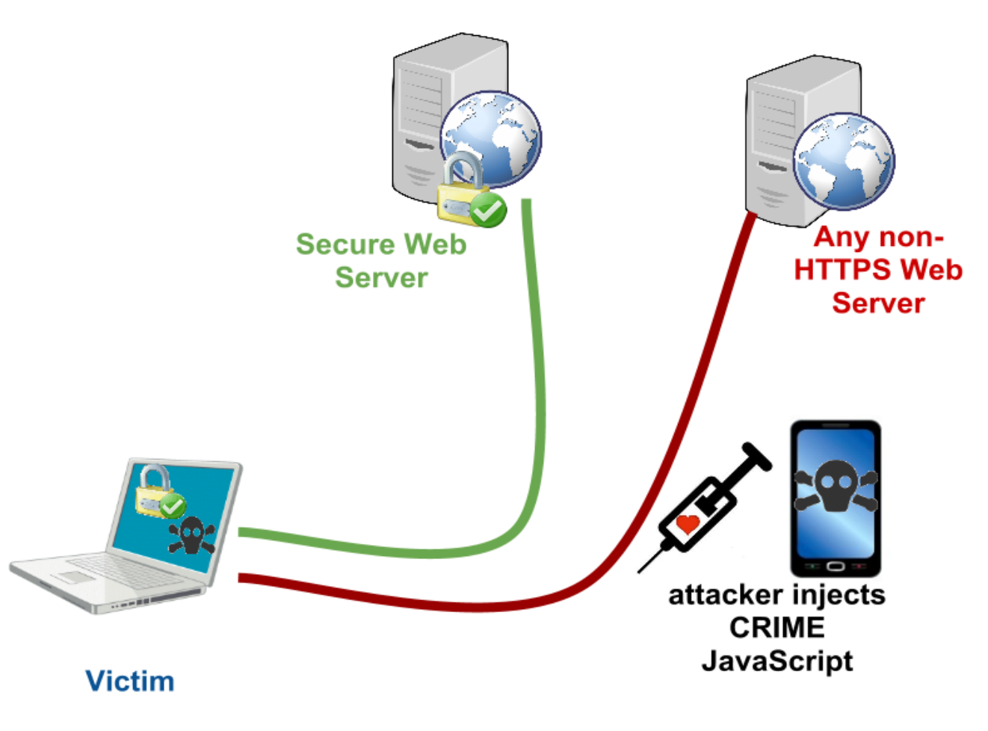
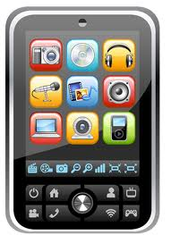
Breach
Backstory: CRIME
Decrypts HTTPS traffic to steal cookies and hijack sessions. Requirements to become a victim:
Attacker can sniff your network traffic.
Victim visits evil.com
Both the browser and server support any version of TLS compression or SPDY
*
Previously Vulnerable
Never Vulnerable
Gmail, Twitter, Dropbox, GitHub, etc.
“42% of sites surveyed by his service support TLS compression.” Ivan Ristic
https://www.ssllabs.com/index.html

Slide 51
Breach
Compression Overview
DEFLATE
LZ77: reducing bits by reducing redundancy
Googling the googles -> Googling the g(-13,4)s
Huffman coding: reducing bits by employing an entropy encoding algorithm
AKA. Replace common bytes with shorter codes
Source: BlackHat - https://media.blackhat.com/us-13/US-13-Prado-SSL-Gone-in-30-seconds-A-BREACH-beyond-CRIME-Slides.pdf

Slide 52
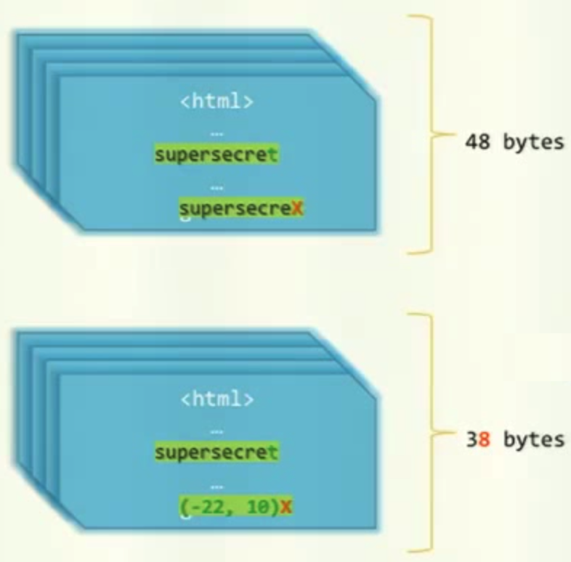
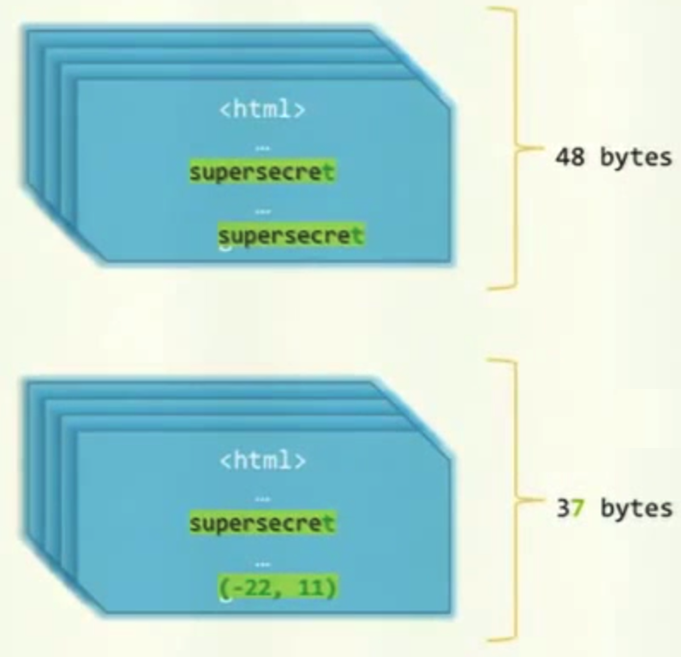
Breach
supersecreX VS. supersecret
Source: BlackHat - https://media.blackhat.com/us-13/US-13-Prado-SSL-Gone-in-30-seconds-A-BREACH-beyond-CRIME-Slides.pdf

Slide 53
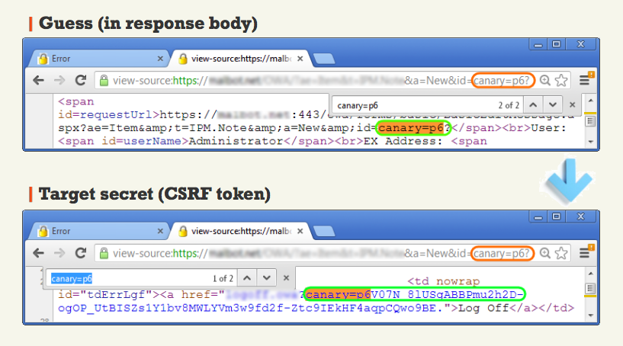
Breach
Source: BlackHat - https://media.blackhat.com/us-13/US-13-Prado-SSL-Gone-in-30-seconds-A-BREACH-beyond-CRIME-Slides.pdf
Notes:
matt

Slide 54
Breach
GZIP
Very prevalent
Highly impractical to turn off
Any browser, any web server
Fairly stable pages
It only takes one
Less than 30 seconds for simple pages
Minutes to hours for more complicated dynamic bodies
MITM / Traffic Visibility
No tampering / SSL downgrade
SSL / TLS [any version]
Could be turned off
A secret in the response body
CSRF, SID, PII, ViewState
and much more
Attacker-supplied data
Guess (response body reflection)
Three-characters prefix
To bootstrap compression

Slide 55
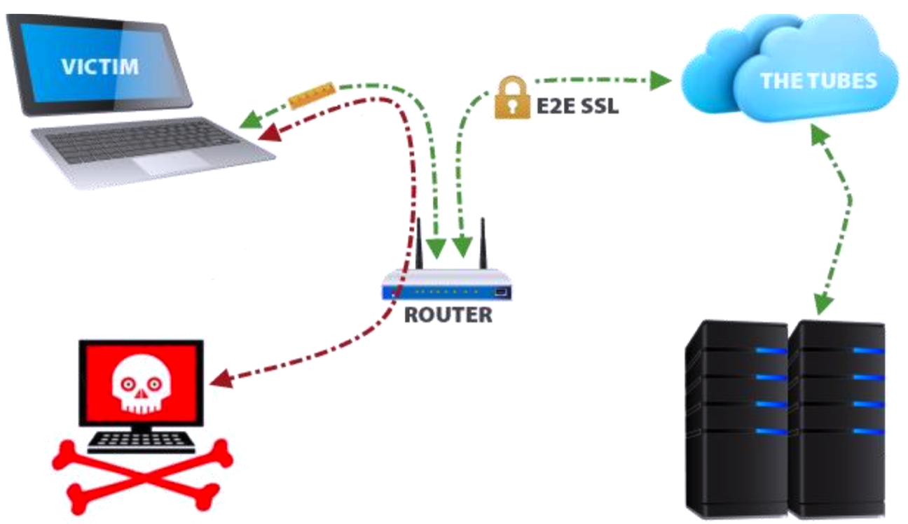
Breach
Architecture
Source: BlackHat - https://media.blackhat.com/us-13/US-13-Prado-SSL-Gone-in-30-seconds-A-BREACH-beyond-CRIME-Slides.pdf

Slide 56
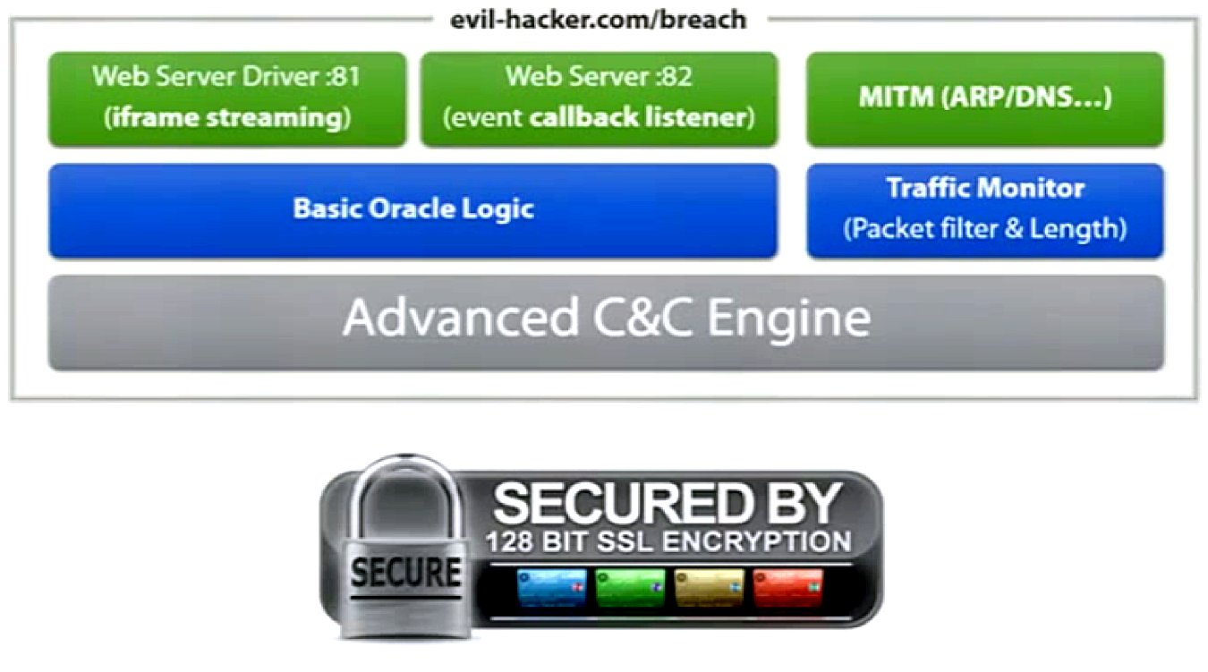
Breach
Command & Control

Slide 57
Breach
Exploitation Tool
Guessing byte-by-byte one character at a time
Random amount of padding
Collisions:
Attempt recovery for multiple winners
Detect & roll-back from wrong path
Begin guessing the secret
https://target-server.com/page.php?blah=blah2…
&secret=4bfb

Slide 58
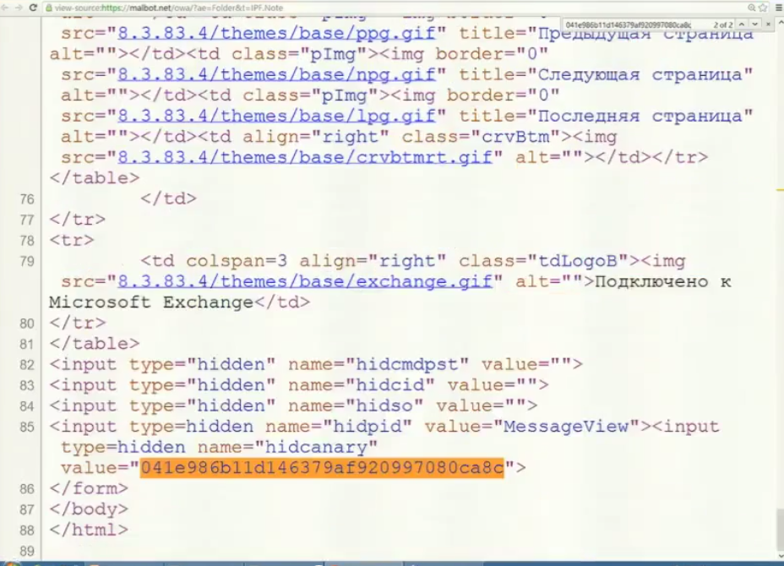
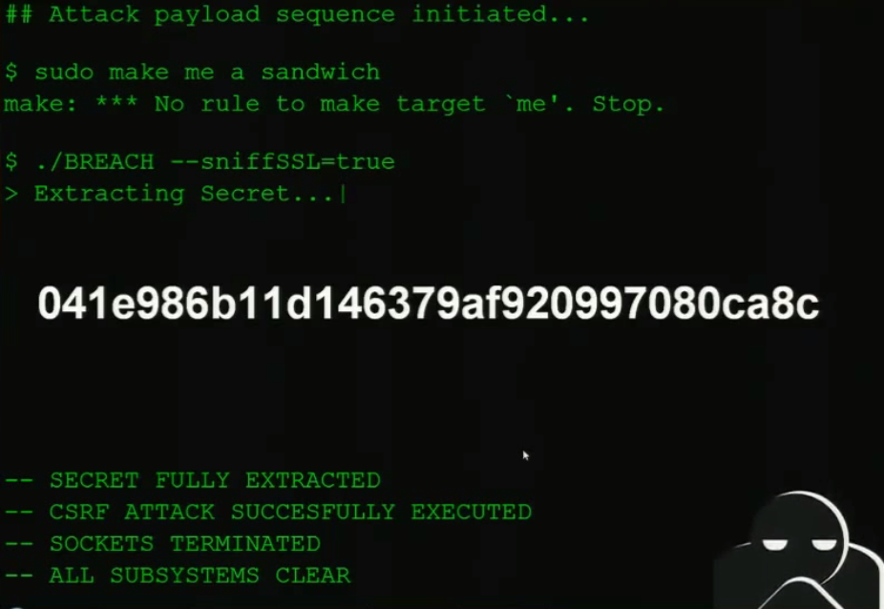
Exploitation Tool

Slide 59
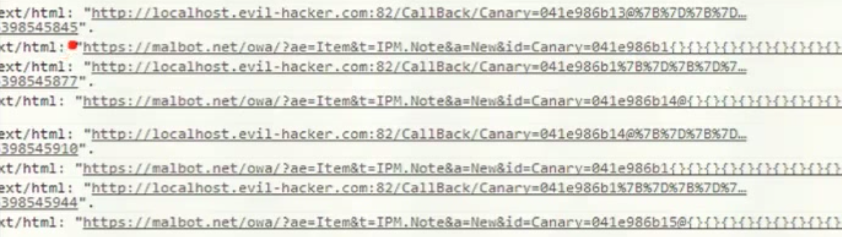

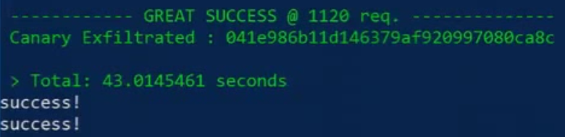
Breach
Successfully guessing the CSRF token

Slide 60
Breach
Mitigation
Randomizing the length
Variable padding
Fighting against math
Dynamic Secrets
Dynamic CSRF tokens per request
Masking the Secret
Random XOR: easy, dirty, practical
Separating Secrets
Deliver secrets in input-less servlets
Chunked secret separation
CSRF protect everything
Unrealistic
Throttling & Monitoring
Disabling GZIP
For dynamic pages

Slide 61

1
Mutation XSS
“This attack labeled Mutation-XSS (mXSS) is capable of bypassing high-end filter systems by utilizing the browser and its often unknown capabilities - every single one of them. We analyzed the type and number of websites that are affected by this kind of attack. The presentation details what mXSS is, why mXSS is possible and why it is of importance for defenders as well as professional attackers to be understood and researched even further.”
Mario Heiderich
https://www.hackinparis.com/talk-mario-heiderich

Slide 62
Mutation XSS
XSS Defense Assumptions
1) Reflected XSS from URL / Parameters
Input can be filtered
2) Persistent XSS by saving something to the application
Output can be filtered
Determinations can be made to tell good HTML from bad HTML(sometimes)
3) DOMXSS via DOM Properties
No unfiltered DOMXSS sources
DOMXSS sinks must be carefully inspected
Not as impossible to fix as some may make you believe
With input validated across the board with a strict whitelist + CSP + XSS protection headers we “SHOULD” be able to mitigate XSS

Slide 63
Mutation XSS
A little bit of history
Microsoft added a particular DOM property for convenience
In IE4
Gave us access to manipulate the DOM
Didn’t have to actually manipulate it yourself, you let the browser do it
Element.innerHTML
Direct access to the elements HTML content
Ammending it by reading or writing to it
Much easier to use than the traditional way of modifying the DOM

Slide 64
Mutation XSS
One’s easily more convenient than the other
// The DOM way var myId = “spanID”; var myDiv = document.getElementById(“myDivId”); var mySpan = document.createElement(‘span’); var spanContent = document.createTextNode(‘Bla’); mySpan.id = mySpanId; mySpan.appendChild(spanContent); mySpan.appendChild(spanContent); myDiv.appendChild(mySpan); // The innerHTML way var myId = “spanID”; var myDiv = document.getElementById(“myDivId”); myDiv.innerHTML = ‘<span id=“’ + myId + ‘”>Bla</span>’;

Slide 65
Mutation XSS
Pros and Cons
Yay
It’s easy
It’s fast
It’s now a standard
It just works
Nay
Not friendly with tables
Slow on older browsers
No XML
Not as “true” as real DOM manipulation

Slide 66
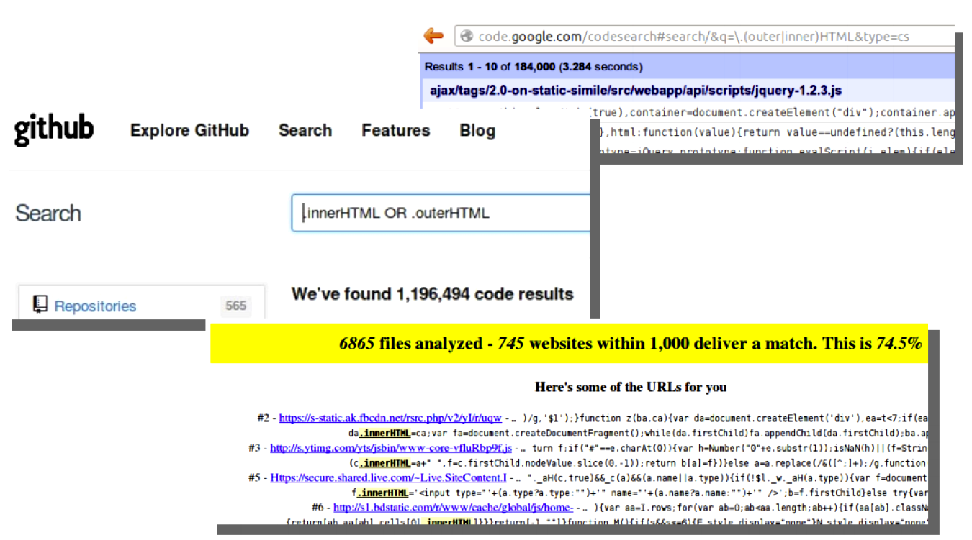
Mutation Xss
Usage in the wild

Slide 67
Mutation XSS
More assumptions
It would make sense if we were to assume that:
f(f(x) == f(x)
Idempotency
An elements innerHTML matches exactly what it is
Sadly it doesn’t
It’s non-idempotent and changes!
Usually that’s fine
Performance
Fixes bad markup that interferes with proper structure
Illegal markup in a true DOM tree

Slide 68
Mutation XSS
http://html5sec.org/innerhtml/
Test-suite so that you can see the effects of innerHTML
Screenshots to follow that recreate his live demo

Slide 69
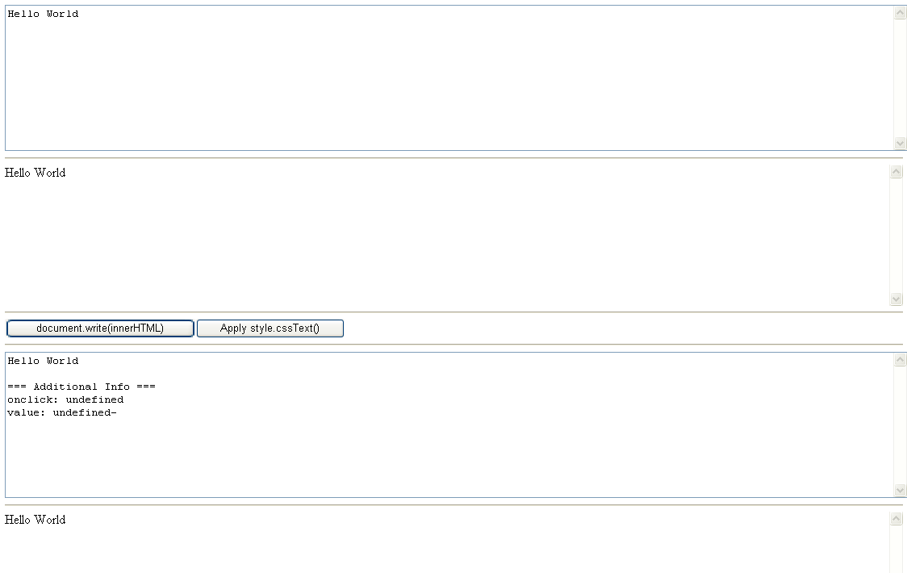
Mutation XSS

Slide 70
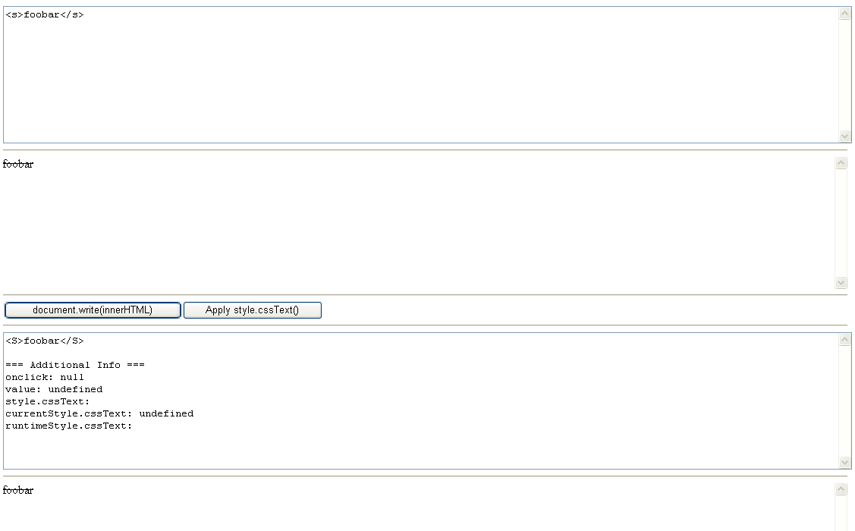
Mutation XSS
Notes:
Here you can see that when we supply some text within s tags the browser actually converts that to uppercase S tags. That makes sense because in HTML4 it was the standard that element names were uppercase. Nothing wrong here, moving on.

Slide 71
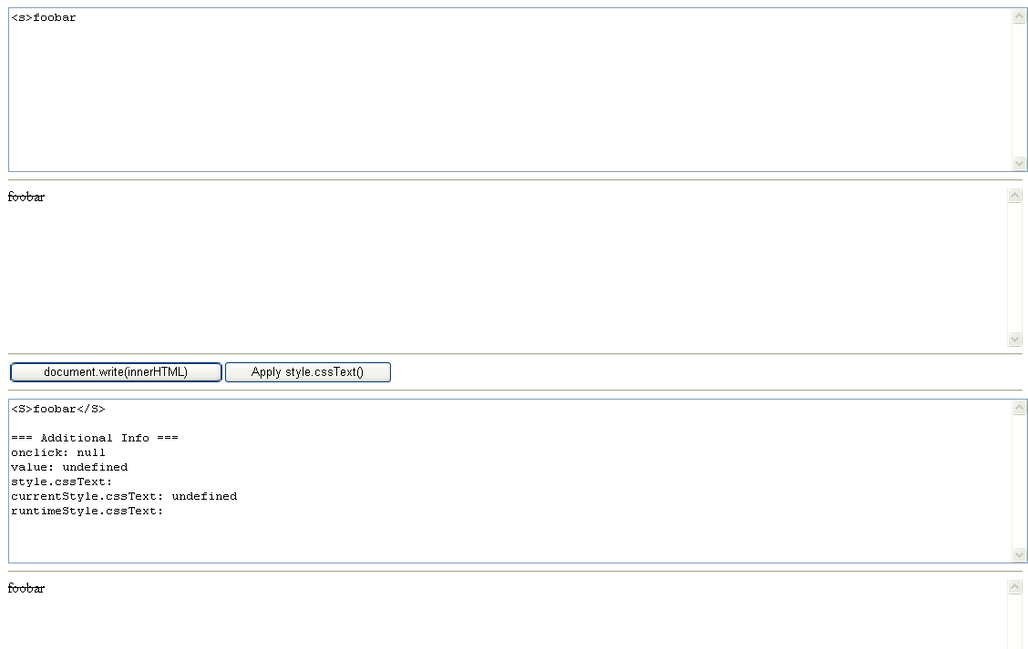
Mutation XSS

Slide 72
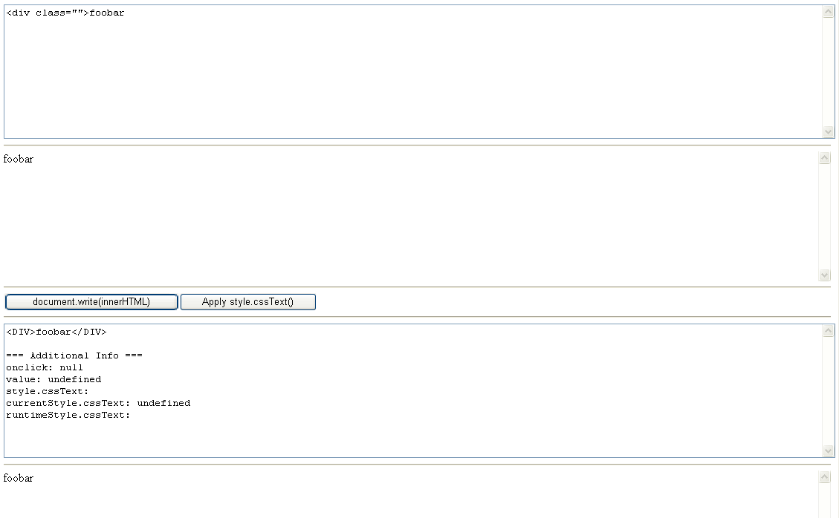
Mutation XSS

Slide 73
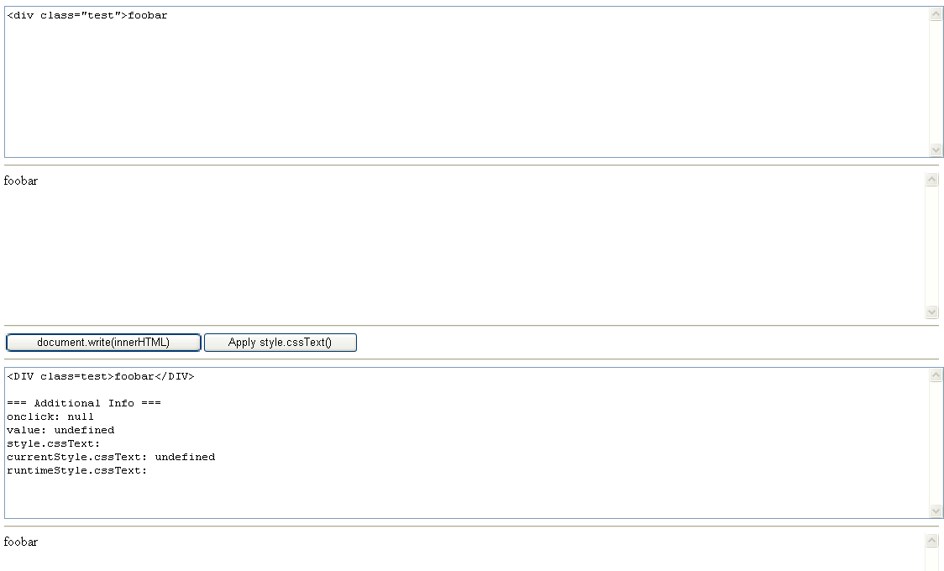
Mutation XSS

Slide 74
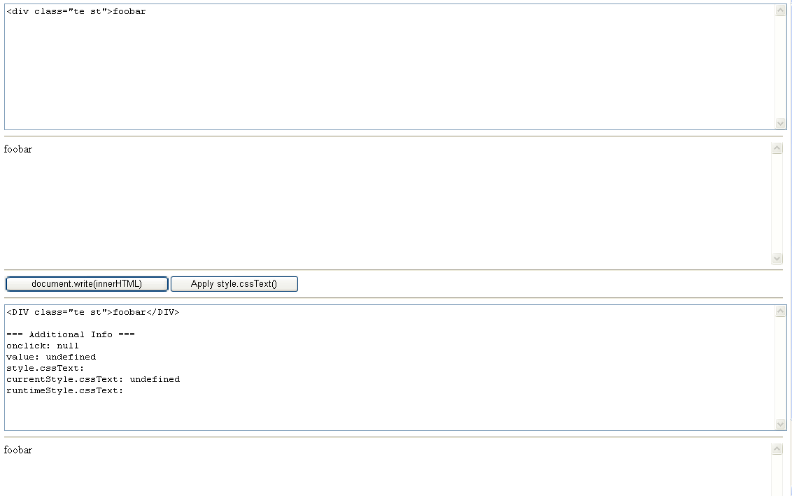
Mutation XSS

Slide 75
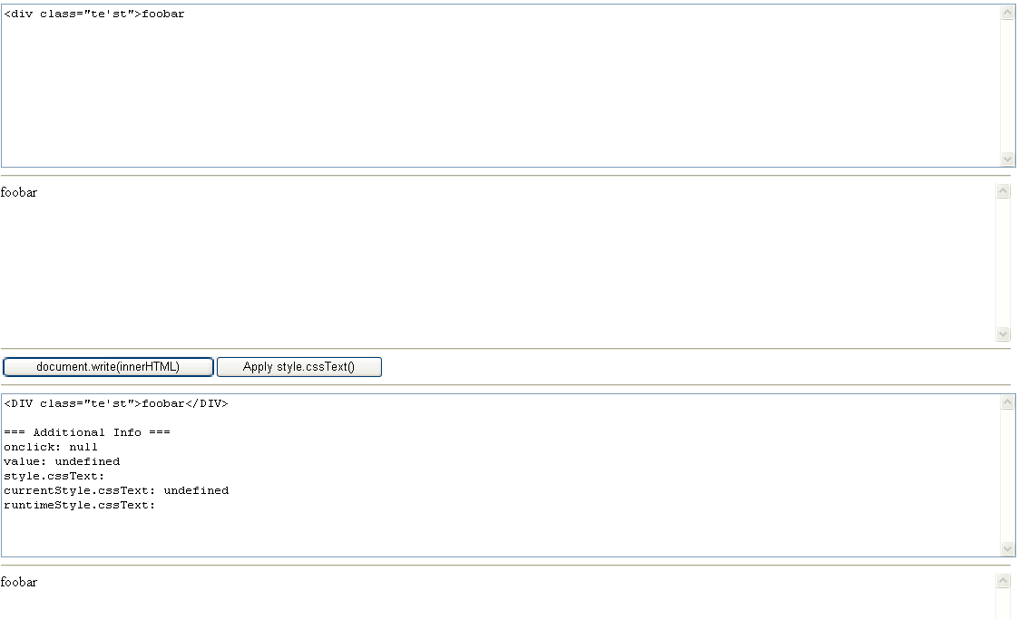
Mutation XSS

Slide 76
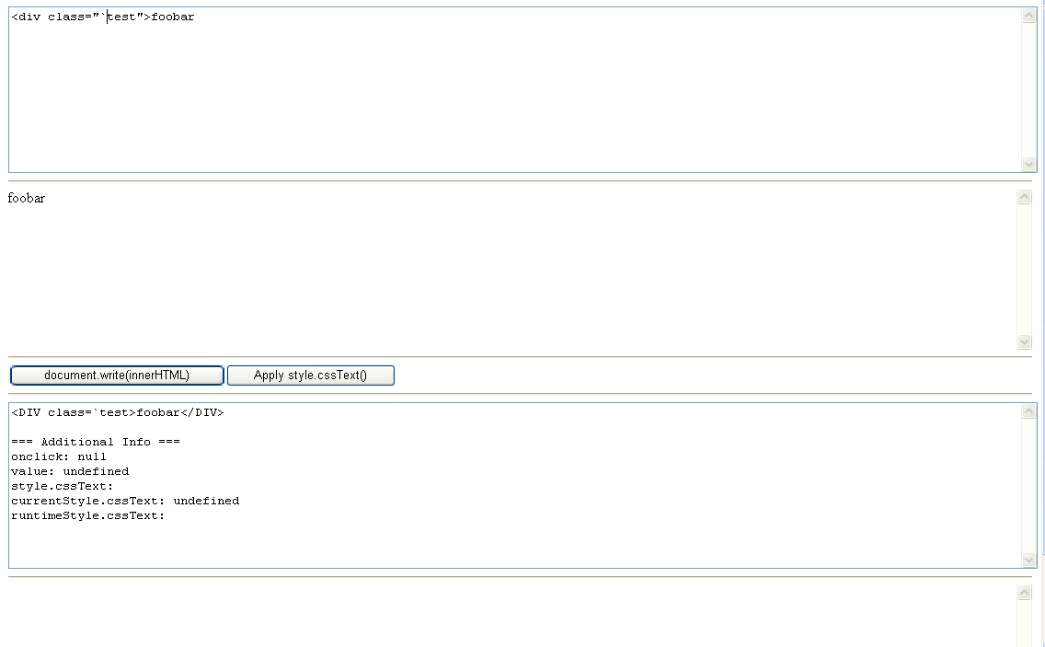
Mutation XSS

Slide 77

Mutation XSS

Slide 78
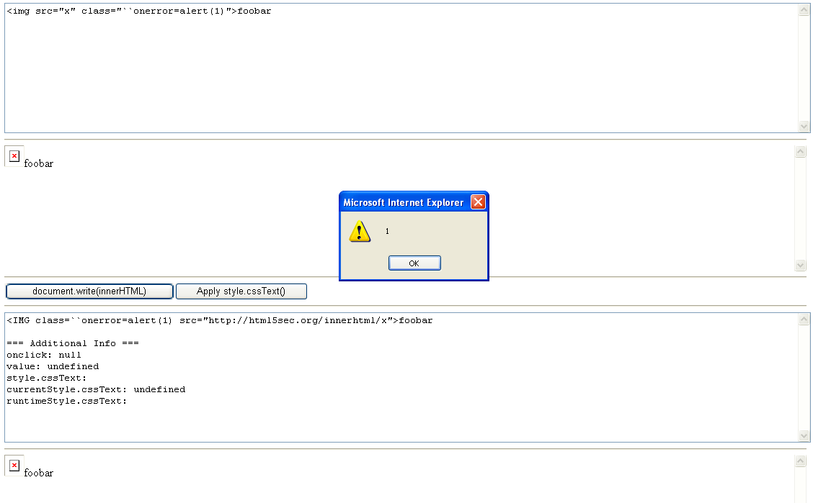
Mutation XSS
Test-suite so that you can see the effects of innerHTML
Screenshots to follow that recreate his live demo

Slide 79
Mutation XSS
MXSS Credits
Gareth Heyes
Yosuke Hasegawa
LeverOne
Eduardo Vela
Dave Ross
Stefano Di Paola

Slide 80
WHAT WE’VE LEARNED

Slide 81
Lessons
What’s old is new and improved: Many Web attack techniques from previous years, including those not appearing on the Top Ten, are constantly being improved. Researchers leverage new technology functionality and combine previously known techniques and produce combinations.
Encryption: TLS related attack techniques, by Juliano Rizzo and Thai Duong, took the #1 spot 3 years in a row (CRIME in 2012, BEAST in 2011 and Padding Oracle in 2010). 3 of the top 5 in 2013 are very similar. Web security community respects deep technical research
Creativity: In 2013 we saw attack techniques that ranged from simple concepts adapted in a unique way to cause a problem, to deep technical and theoretical research on encryption and TLS flaws. It just goes to show us that taking something simple and looking at it in a new light might be all it takes at times.

Slide 82
Thank you to…
All Web security researchers
Panel of Judges: Peleus Uhely, Jeff Williams, Dan Kaminsky, Romain Gaucher, Saumil Shah, Giorgio Maone, Troy Hunt, Ivan Ristic
Everyone in the Web security community who assisted with voting
Matt Johansen
Threat Research Center, Manager
Twitter: @mattjay
Email: matt@whitehatsec.com
Johnathan kuskos
Threat Research Center, Supervisor
Twitter: @JohnathanKuskos
Email: johnathan.kuskos@whitehatsec.com

